Slide 1
Construction & Consulting Opportunities
OGS Design & Construction Group

Slide 2
Contracts Awarded: Oct. 2014 – Sept. 2015
276 Construction Contracts – $294.8M
257 Emergency Contracts – $55.5M
99 Consulting Contracts – $89.0M
632 Contracts totaling $439.3M

Slide 3
Major Projects – Recently Bid
Harriman Campus – Daycare Center $9.12M
Fiver Rivers – Visitors Bldg. & Site Improvements $8.02M
Camp Smith – Training Site $6.54M
Coxsackie CF – Electrical Distribution Rehab $5.97M
Elmira CF – Building 20 Plumbing $4.25M
Upstate CF – Replace Training Building $3.50M
NYC Armory – Drill Hall Roof $3.48M

Slide 4
Major Projects Bidding before 12/31/15
Manhattan PC – Major Building Renovations $134.8M
Albany Training Academy – Expand & Renovate $21.0M
Fishkill CF – Rehab Kitchen & Mess Hall $17.5M
Willard DTC – Electrical Distribution System $13.9M
Wallkill CF – Perimeter Security System $13.4M
NYS Police Hempstead – Zone Headquarters $11.7M
NYS Police Canandaigua – Forensics Bldg. $9.5M

Slide 5
Take Advantage of OGS Opportunities!
Familiarize yourself with the OGS D&C website
Contractors: complete a Vendor Interest Profile.
Apply for the Emergency Bidders list!
Use Previously-Approved Construction Vendors list to identify potential subs.
Large projects: Attend and network at pre-bid conferences.
Consultants: Review posted Utilization Plans to identify subconsultant opportunities.
Need assistance? The OGS MWBE Office is available….

Slide 6
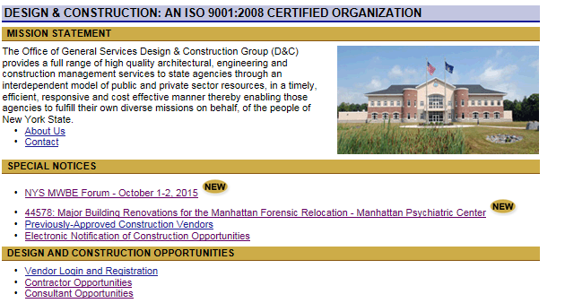
OGS Bid Opportunities: www.ogs.ny.gov/BU/DC

Slide 7
Another Opportunity
Award 22872 - Hazardous Incident Response Equipment (HIRE):
It includes all types of hazardous equipment like decontamination showers, protective gear, and test kits for air quality.
Overall value $125 Million - Five (5) year term
45 contractors: manufacturers & authorized distributors
18 Categories; 5 Categories with MWBE goals of 20% (10% MBE, 10%WBE)

Slide 8
Special Notice for MWBE Forum:
Key website links for OGS D&C Opportunities
Copy of PowerPoint© slides for today’s presentation

Slide 9
Questions??

