Slide 1
Group: 20600, Award PGB-23063 GR, RM Floor Coverings and Related Services (Statewide)
How to Use the Floor Covering Contract
The webinar will begin at 1:00 PM.

Slide 2
Procurement Services Contact Information
Contract Management Specialist:
Dana Ferris, dana.ferris@ogs.ny.gov, 518-474-3382
Contract Management Specialist 2:
Ruth K. Quezada, ruth.quezada@ogs.ny.gov, 518-473-2801
Questions regarding the contract should be submitted to the above contacts.

Slide 3
Agenda
Introduction
How to find the Contract Documents
Landing Page
Contract Information Summary Page
Typical Flooring Project
Flooring Selection
Prevailing Wage Rates and Certified Payrolls
Request for Quote
Installation Site Visit
Quote Evaluation
Award the Project/Project Monitoring
Questions

Slide 4
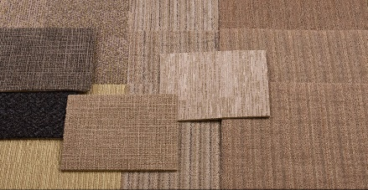
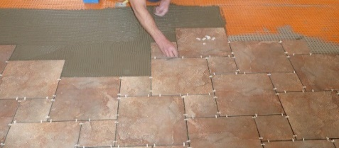
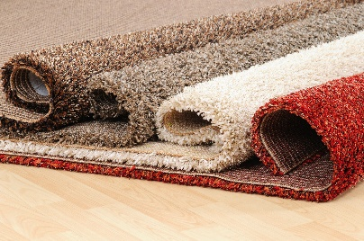
Introduction
In accordance with New York State Finance Law §163(10)(e), New York State Office of General Services (OGS) Procurement Services has completed a piggyback off of the National Joint Powers Alliance (NJPA) Contract for Flooring with related services.
This contract allows New York State Authorized Users (AUs) to purchase multiple types of flooring, as well as, the installation of the flooring by conducting a request for quote.

Slide 5
Introduction – cont’d
On June 30, 2017, OGS Procurement Services issued awards to Contractors under Group: 20600 Award: PGB-23063 for Floor Coverings and Related Services.
This Contract offers floor covering options from seven (7) Contractors, including broadloom carpet, carpet tile, vinyl tile and installation of these materials are available under this contract.
The primary goal of this webinar is to present information on the use of the contract and to present tools that can help you use the contract to get the most competitive pricing for your flooring project.

Slide 6
How to Find the Contract
The contract and corresponding information is located on the New York State, Office of General Services website at https://www.ogs.ny.gov
Click “Procurement”
Click “Go To The Procurement Services Website”
Click “Find Contracts”
Click “Commodity Contracts”(Located under the Procurement Centralized Contracts)
Click Group “206” Carpets, Carpet Tiles, & Rugs
Click Group-Award “20600-23063” Floor Covering (NJPA)
Below is the direct link to the Floor Coverings and Related Services Contract https://www.ogs.ny.gov/purchase/spg/awards/2060023063CAN.HTM

Slide 7
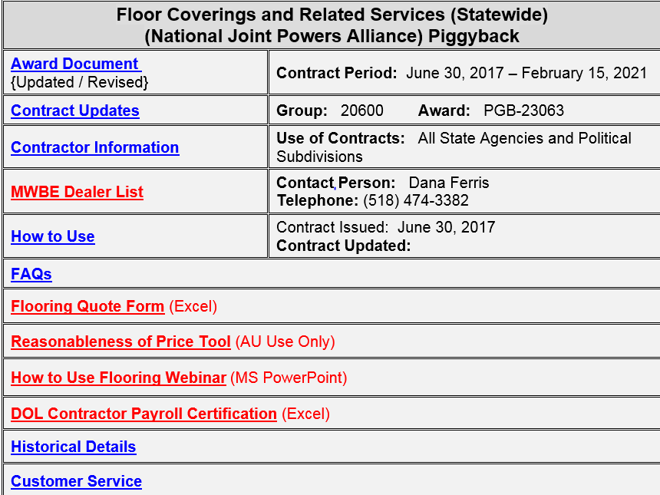
Landing Page Contents
Award Document – Award/Contractor Information, OGS Contact
Contract Updates – Contains all Contract Award Updates
Contractor Information – Executed Contract, Price List and Dealer listing. (Covered in next slide)
MWBE Dealer List – Listing of all MWBE Dealers
How to Use – Information on how to use this contract.
FAQ’s – Frequently Asked Questions/Answers
Flooring Quote Form – OGS recommend quote template.
Reasonableness of Price Tool – AU tool for checking ROP
DOL Certified Payroll – Optional Contractor Payroll Record
Historical Details – Historic Details of contract.
Customer Service – Contact information & Performance Report.

Slide 8
Contractor Information Summary Page
The Contractor Information Summary page contains all the pertinent information about each Contractor and provides links to the Contractor’s Price List, Piggyback Agreement, and Dealer List. All contract holders have their information available on this page in the same format.
On the next page, is a sample of the information from one of the Contractors under this contract, Bentley Mills.
.

Slide 9
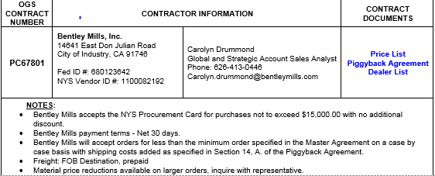
Contractor Information Summary Page – cont’d
Price List - Contractors Price List of offerings
Piggyback Agreement - NYS Centralized Contract for the Contractor
Dealer list – Contractors Authorized Dealers
The Notes field is where AUs can locate information in regards to each Contractors payment and shipping terms.

Slide 10
Typical Flooring Project
The typical flooring project has six steps:
Flooring Selection
Request for Quotes (RFQ)
Installation Site Visit
Quote Evaluation
Awarding the Project
Project Monitoring

Slide 11
Flooring Selection
AUs shall determine which type of flooring they need.
AUs should contact the Contractor’s Representative and/or Dealer for assistance in selecting the flooring.
There are seven (7) Manufacturers, referred to as Contractors, who hold contracts under this Award. All of the Contractors have Dealers who can sell and install their products.
PC67801 Bentley Mills, Inc.
PC67773 Interface Americas, Inc.
PC67774 Mannington Mills, Inc.
PC67800 Masland Contract Flooring
PC67775 Mohawk Carpet Distribution, Inc.
PC67778 Shaw Industries, Inc. Dba Shaw Contract
PC67779 Tandus Centiva US LLC

Slide 12
Flooring Selection – cont’d
If the AU knows the manufacturer (Contractor) of the flooring type and style that is needed, the AU should contact three or more Dealers off the Contractor’s Dealer List to invite them to the installation site visit and request a quote for the flooring project.
If the AU is not sure what type of flooring is needed, it is recommended that AUs reach out to Dealers that represent multiple Contractors to help refine their choice of a flooring selection. Then, the AU will contact at least three Dealers off the Contractors Dealer List to invite them to the site visit and request a quote for the flooring project.
AUs can request flooring samples from both the Contractors or the Dealers.
The Flooring Quote Form should be used to request quotes and to evaluate the reasonableness of the prices quoted. (More on this later in the presentation.)

Slide 13
Prevailing Wage Advisory
Per Article 8 of the New York State Labor Law for Construction contracts, Dealers are required to pay the installers prevailing wage rates and supplemental benefit rates per the prevailing wage rate schedule for the county the project is taking place in.
AUs must obtain PRC#s (Prevailing Rate Case numbers), a project specific prevailing wage rate schedule from the Department of Labor (DOL).
https://applications.labor.ny.gov/wpp/showPublicNewProject.do?method=showIt
Installation job titles covered under this Contract fall under the Carpenter title.

Slide 14
Request for Quote
When used in conjunction with a successful site visit, the Flooring Quote Form provides all the information needed which will make quote evaluation easier.
AUs should complete the quote form providing as much information as possible so the Dealers can assess their availability and have a good understanding of the scope of the work, the products to be supplied, and when the work needs to be completed. (Refer to the quote form for additional information.)
Make sure Dealers quote the number of labor hours the installation will take. (This number will be used later in the evaluation process.)

Slide 15
Request for Quote – cont’d
The Flooring Quote Form should be sent to all the Dealers in the geographic area of the project that carry the desired manufacturer’s (Contractors) flooring. The more competition the better the chance for savings.
If less than three quotes are received, the AU should:
Ask dealers the reason they did not quote to determine if another site visit is needed.
Document justification for selecting the Dealer awarded – including Reasonableness of Price.
There are currently between 17 and 70 Dealers available on the each Contractors approved Dealer lists.
There are currently 16 MWBE Dealers on the Contractors approved MWBE Dealer list. Please make sure to check the Dealer Lists as Dealers are added throughout the life of the Contract.
Considering the ample number of Dealers throughout New York State there should be no problem getting three quotes.
If AUs have difficulty getting three quotes please contact the OGS contract manager for assistance.

Slide 16
Installation Site Visit
Flooring projects typically require a Site Visit. Site Visits provide an opportunity for AU’s and Dealers to obtain information to ensure that the RFQ process produces the best possible outcome.
Authorized Users should attempt to solicit quotes from three or more Dealers. It is recommend for AU’s to hold one site visit, so all Dealers receive the same information at the same time. If scheduling conflicts arise that prohibits this, it may be best to postpone and reschedule the Site Visit.
The goal is to receive a minimum of three quotes.

Slide 17
Installation Site Visit – cont’d
AU Benefits:
Make their expectations clear to Dealers
What is being done, where is the work being performed, when (regular business hours, nights, weekends, etc.) will the work need to occur.
Obtain a consensus from the Dealers to ensure projects are quoted similarly
What materials? extra stock, samples needed, cove base required, EO4 flooring and if Dealer should quote as specified or equivalent.
Dealer Benefits:
Understand the layout and site access restrictions – will furniture moving be required?
Obtain proper measurements for quoting
Identify the flooring being removed and any disposal requirements any floor preparation (when applicable)
All of these are labor costs and have a Not to Exceed Price (square yard, square foot or linear foot) on Contractors’ Price List.

Slide 18
Installation Site Visit – cont’d
Make sure all attendees sign-in.
If relevant questions are asked by a Dealer – during or after the Site Visit - make sure all attendees (Dealers) get the same information. This ensures all Dealers are bidding on the same requirements.
You can use this as an opportunity to remind the Dealers to quote competitive line item pricing below the Not to Exceed Price on the Contractors’ Price Lists. This includes both material and installation costs.
If installation will be performed by the AUs staff and the AU knows which flooring materials are required, the AU may contact the manufacturer directly to be quoted pricing for a direct ship. Doing so may provide cost savings due to the AU not needing the services of the Dealer.

Slide 19
Quote Evaluation
Since Dealers are quoting the same materials and the same scope of work for installation, the quotes should contain the same line item material and installation line items. The only difference should be the unit prices each Dealer quotes.
Material prices are straight forward, you should be quoted a price per Unit (square yard square foot, etc.) indicated on the Price List. Prices must be equal to or less than the Not to Exceed Price on the Price List. Larger projects typically garner lower per square yard or foot prices.
Dealers earn a commission on the final sale price of the flooring material from the Contractors so there is a profit margin for the Dealer to supply the material to the AU.
AUs are encouraged to seek lower material prices from Dealers.
The prices on the Price List are Not to Exceed Price. Quotes should be far less.

Slide 20
Quote Evaluation – cont’d
Prices quoted for installation (Labor) are quoted in square yard (SY) or square foot (SF) or by linear foot (LF).
To evaluate if the prices quoted in SY, SF or LF are reasonable, you can compare the total installation price quoted (#1) from your quote (includes labor, profit and overhead) to the result of the total number of labor hours proposed multiplied by the prevailing wage rate including supplemental rate (Labor only) (#2).
The prevailing wage and supplemental benefit rates times the number of labor hours result (#2) will be less than the installation cost quoted (#1). The difference is the Dealer profit and overhead (#3). To determine the percent of profit and overhead, take Proposed Dealer quote - proposed labor cost / proposed dealer quote = markup X 100 = % markup (#4).
Does the difference, Dealer profit and overhead, seem reasonable? An example will be provided later in the presentation (Slide 26).

Slide 21
Quote Evaluation Recap
Additional things to consider in the evaluation:
As mentioned previously Dealers earn a commission on the sale price of the flooring material from the Contractor.
Commercial flooring installation profit and overhead margins are typically over 20%. Smaller projects have higher Dealer profit and overhead margins. Larger projects have lower profit and overhead margins.
Only by creating competition can you get the most competitive prices.
It is acceptable to ask for a best and final offer.
The goal is to get the most competitive price for your project while allowing a fair profit for the Dealer.

Slide 22
Awarding the Project
Once the AU has completed the evaluations, it is time to award the project.
Identified low bidder
Resolved any questions about the quote
Deemed the pricing as reasonable
The AU should issue a purchase order to the Dealer so the materials can be ordered and the installation can be scheduled.

Slide 23
Project Monitoring
During the project, AUs should:
Inspect the materials before the installation to verify they are as quoted and ordered.
Require a sign in sheet for installers to track time installers are working on the project
Compare the sign in sheet to the certified payroll report to confirm that they match, as a best practice (more on this later).
Monitor the progress of the installation and be available for Dealer questions.
Inspect the finished project with the Dealer to resolve any installation issues and get them taken care of before the Dealer leaves.

Slide 24
Project Monitoring – cont’d
DOL Contractor Payroll Certification
Certified payrolls are a certification that Dealers are paying installers at least prevailing wage rates and supplemental benefits.
Certified payrolls also provide the installers names and the hours they worked on your project. This information is important for two reasons:
As a best practice they should be reviewed to confirm prevailing wage and supplemental benefit rates are paid to installers.
They should be retained as part of the procurement record for audit purposes.
OGS provides a fillable copy of the NYS DOL Contractor Payroll Certification form on the Landing Page of the Award. When filled out by the dealer the AU can use them for project monitoring and to verify reasonableness of price.

Slide 25
Project Monitoring – cont’d
As mentioned previously, collect certified payrolls from the Dealer for your procurement record and invoice verification. You can also use the total number of labor hours reported to see how it matches up to the proposed labor hours quoted by the Dealer. You will be able to confirm that you received a fair and reasonable price for your project installation and use the information for reference on future flooring projects.
Compare the total installation price quoted (#1) from your quote (includes labor, profit and overhead) to the result of the total number of Actual labor hours multiplied by the prevailing wage rate including supplemental rate (Labor only) (#2).
The prevailing wage and supplemental benefit rates times the number of Actual labor hours result (#2) will be less than the installation cost quoted (#1). The difference is the Dealer profit and overhead (#3). To determine the Actual percent of profit and overhead, take Proposed Dealer quote - Actual labor cost / proposed dealer quote = markup X 100 = % Actual profit and overhead (#4).
Does the Actual profit, overhead and % of profit and overhead for the installation still seem reasonable? If not, you may want to discuss it with the Dealer to see if a discount off installation cost can be achieved.

Slide 26
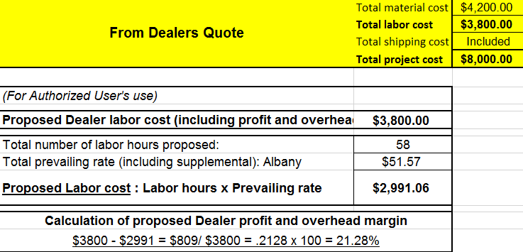
Project Monitoring – cont’d
Reasonableness of Price Tool
#1 Installation Price Quoted (includes labor, profit and overhead)
#2 Proposed labor cost (labor hours proposed times prevailing wage plus supplemental benefit rates)
#3 Dealer profit and overhead (#1 minus #2)
#4 Percent profit and overhead

Slide 27
Summation
Provide as much information on the quote form before sending it out to the Dealers and require the Dealers fill out the quote form completely and correctly.
It will make the comparison easier
You will be able to confirm you received a reasonable price for your project while affording a fair profit for the Dealer
Having a successful site visit is important.
The Dealer will know your expectations
You will have the Dealer’s consensus on what is required in the installation so quotes will be comparable
You can contact the OGS contract manager to answer questions about your project, your quotes or if you need assistance.

Slide 28
Questions
Contract Management Specialist:
Dana Ferris, dana.ferris@ogs.ny.gov, 518-474-3382
Contract Management Specialist 2:
Ruth K. Quezada, ruth.quezada@ogs.ny.gov, 518-473-2801
Team Leader:
Todd Kayser, todd.kayser@ogs.ny.gov, 518-473-6469

